Slide 1
Randomized Algorithms CS648
Lecture 22
Application in routing
Permutation routing on a hypercube
Fixed-path routing

Slide 2
Routing
Distributed
Packet has (source, destination)
Routing table

Slide 3
Dilation :
Congestion :
Queue management :
The maximum length of any path
The maximum number of packets that cross any edge
Policy of breaking ties

Slide 4
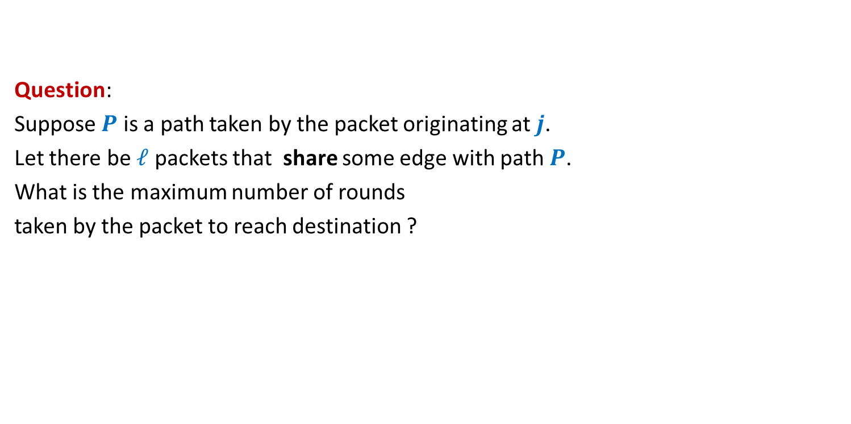
A warm-up question
Question:
Suppose $P$ is a path taken by the packet originating at $j$.
Let there be $ℓ$ packets that share some edge with path $P$.
What is the maximum number of rounds
taken by the packet to reach destination ?

Slide 5




source
$$j$$
Answer: $\left|P\right|+ℓ$
$$P$$
destination

Slide 6
Routing on Hypercube

Slide 7


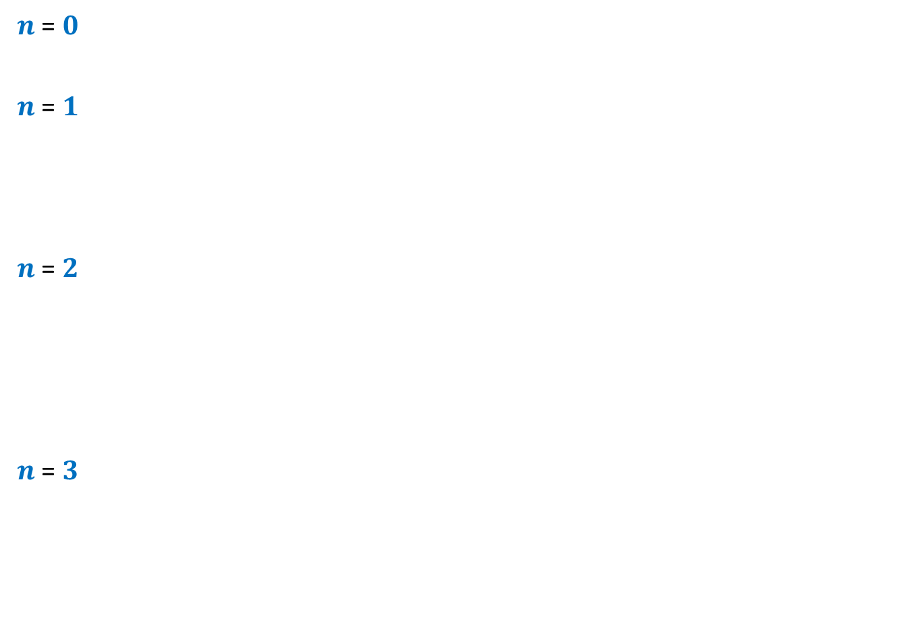













$n$-Hypercube
$n$ = $0$
$n$ = $1$
$n$ = $2$
$n$ = $3$
$$0$$
$$1$$
$$10$$
$$11$$
$$00$$
$$01$$
$$110$$
$$111$$
$$100$$
$$101$$
$$010$$
$$011$$
$$000$$
$$001$$

Slide 8



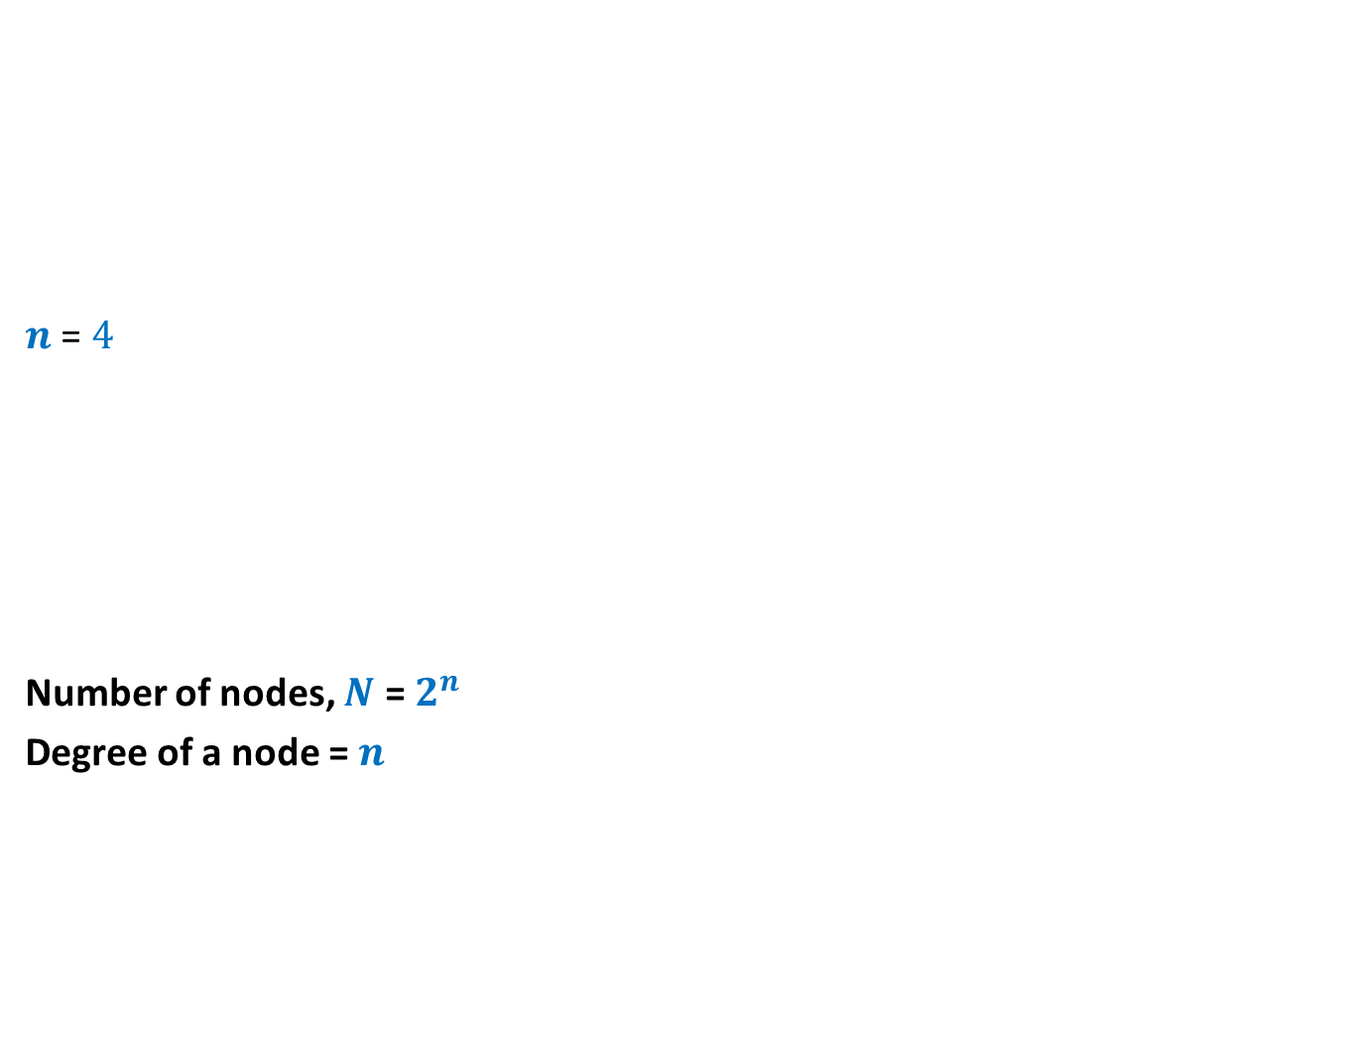













$n$-Hypercube
$n$ = $4$
Number of nodes, $N$ = $2^{n}$
Degree of a node = $n$
$$0110$$
$$0111$$
$$1110$$
$$1111$$
$$0100$$
$$0101$$
$$1100$$
$$1101$$
$$0010$$
$$0011$$
$$1010$$
$$1011$$
$$0000$$
$$0001$$
$$1000$$
$$1001$$

Slide 9
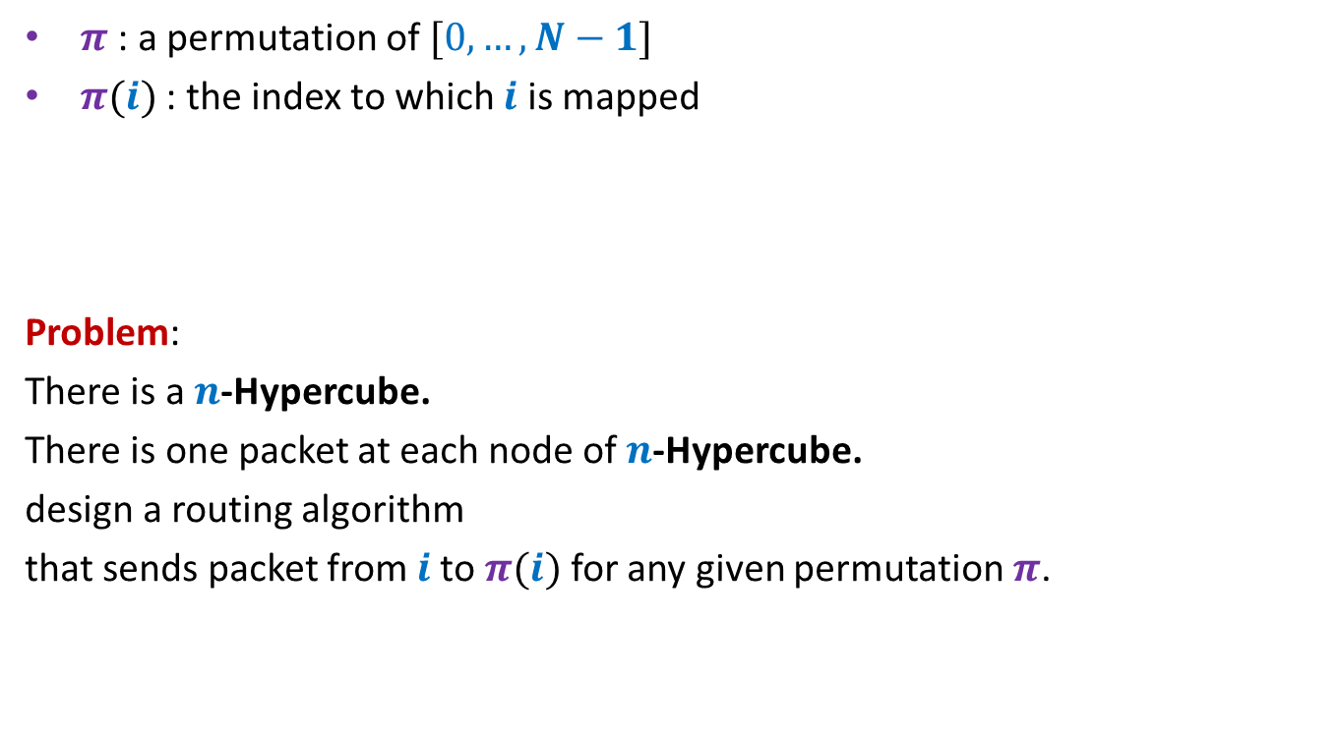

Permutation Routing on a $n$-Hypercube
$π$ : a permutation of $[0,…,N−1]$
$π(i)$ : the index to which $i$ is mapped
Problem:
There is a $n$-Hypercube.
There is one packet at each node of $n$-Hypercube.
design a routing algorithm
that sends packet from $i$to $π(i)$ for any given permutation $π$.

Slide 10

$n$-Hypercube
$n$ = $4$
$$0110$$
$$0111$$
$$1110$$
$$1111$$
$$0100$$
$$0101$$
$$1100$$
$$1101$$
$$0010$$
$$0011$$
$$1010$$
$$1011$$
destination
$$0000$$
$$0001$$
$$1000$$
$$1001$$
source

Slide 11
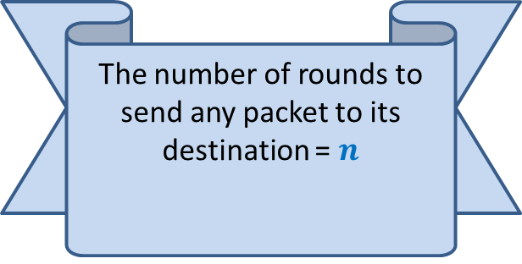
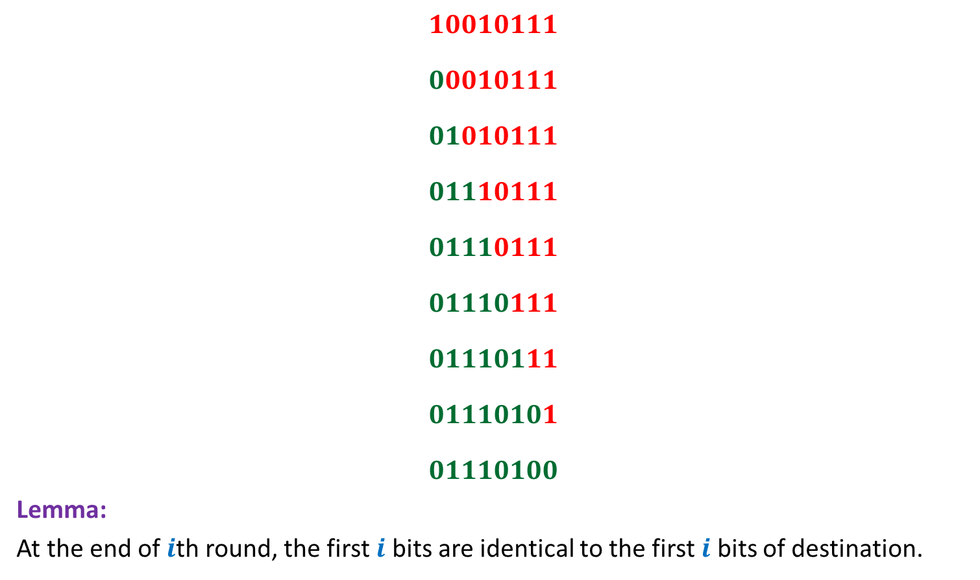
Bit-fixing algorithm
source
$$10010111$$
$$00010111$$
$$01010111$$
$$01110111$$
$$01110111$$
$$01110111$$
$$01110111$$
$$01110101$$
$$01110100$$
Lemma:
At the end of $i$th round, the first $i$ bits are identical to the first $i$ bits of destination.
The number of rounds to send any packet to its destination = $n$
No routing table needed
☺
(if there is no congestion
in the network)
destination

Slide 12
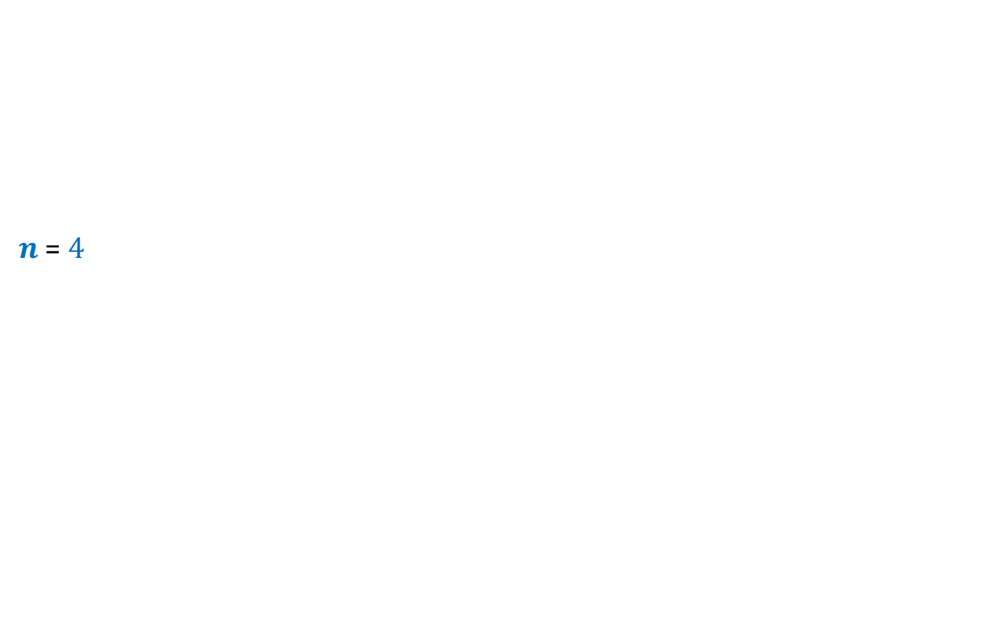
$n$-Hypercube
$n$ = $4$
$$0110$$
$$0111$$
$$1110$$
$$1111$$
$$0100$$
$$0101$$
$$1100$$
$$1101$$
$$0010$$
$$0011$$
$$1010$$
$$1011$$
destination
$$0000$$
$$0001$$
$$1000$$
$$1001$$
source

Slide 13







Worst case Permutation
source
$$a_{1},…{,a}_{\frac{n}{2}}$$
$$,b_{1},…{,b}_{\frac{n}{2}}$$
$$10010111$$
$$00010111$$
$$01010111$$
$$01110111$$
$$01110111$$
$$01111001$$
$$01111001$$
$$01111001$$
$$01111001$$
$N$ messages to pass through $\sqrt{N}$ nodes ➔At least $\frac{\sqrt{N}}{n}$ messages to pass through an edge
$$b_{1},…{,b}_{\frac{n}{2}}$$
$$, b_{1},…{,b}_{\frac{n}{2}}$$
$$b_{1},…{,b}_{\frac{n}{2}}$$
$$,a_{1},…{,a}_{\frac{n}{2}}$$
destination

Slide 14
How to use Randomization to avoid congestion?
Let us analyse a related problem

Slide 15
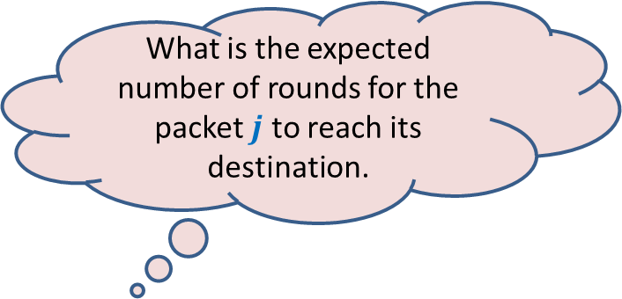

Send each packet to a uniformly random destination
For a packet originating from node $j$,
Pick a destination $r(j)$ randomly uniformly and independently
Send the packet to $r(j)$ using Bit-fixing algorithm
What is the expected number of rounds for the packet $j$ to reach its destination.

Slide 16

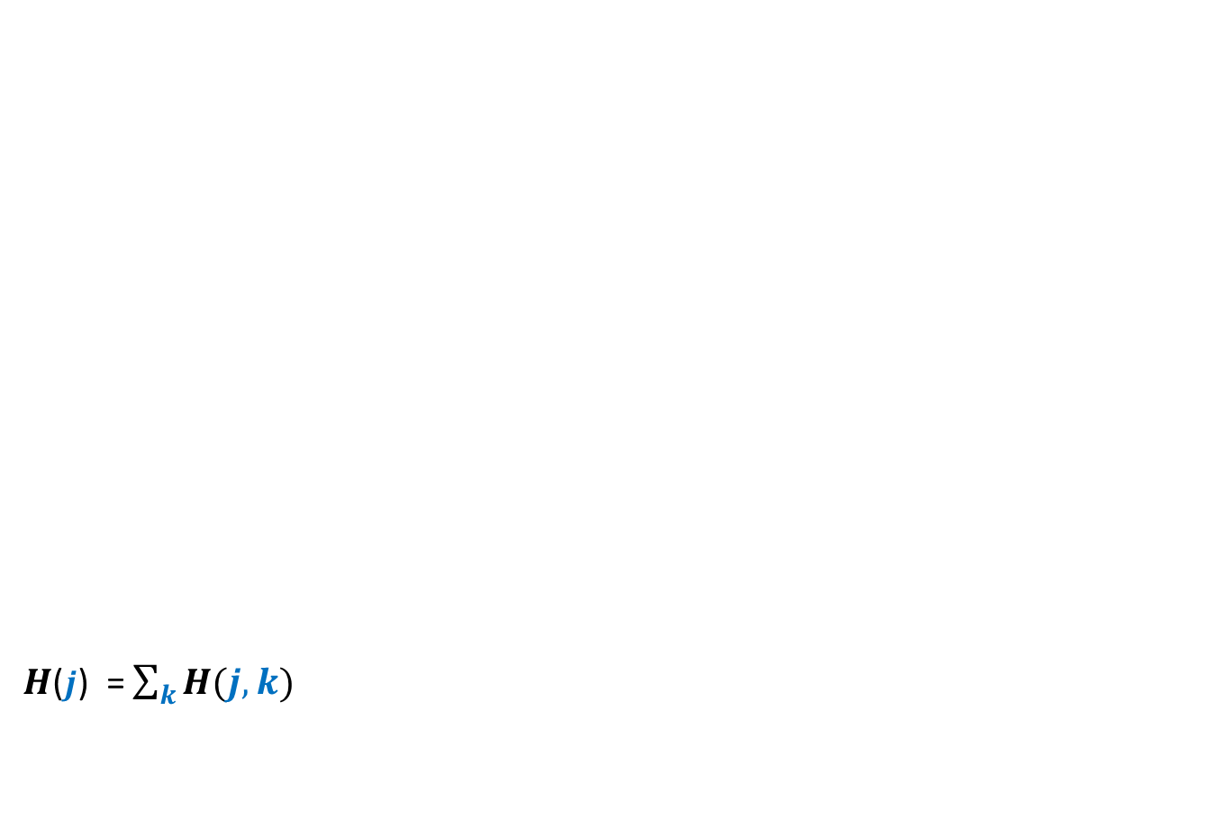


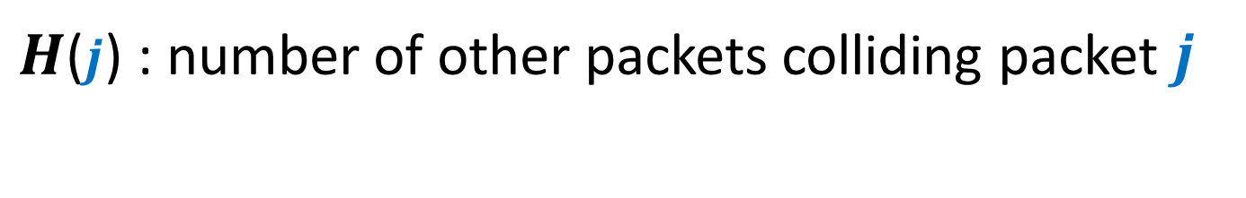



$H$($j$) : number of other packets colliding packet $j$
$$ℓ$$
source
$$j$$
$H$($j$) = $\sum_{k}{H(j,k)}$
It seems difficult to compute E[$H\left(j,k\right)$] since the corresponding probability depends upon $j$as well as $k$.
Any relation between $H(j,k)$ and $H(j,ℓ)$ ?
$$P$$
$$k$$
They are independent ☺
So we take an alternate approach.
We focus on any path taken by packet $j$.
destination
$$H\left(j,k\right)=\left\{\begin{aligned} 1 if packet originating from k collides with j \\ 0 if packet originating from k does not collide with j\end{aligned}\right.$$

Slide 17


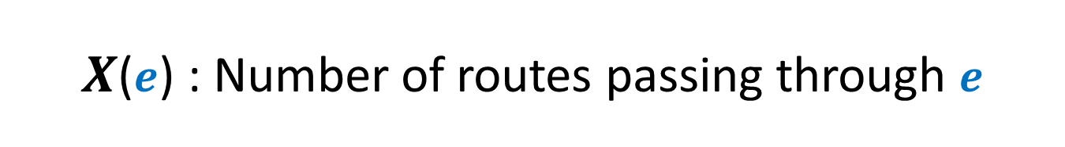


$X$($e$) : Number of routes passing through $e$
source
$$j$$
$$P$$
$$01010011$$
$$e$$
$$01000011$$
Focus on an edge of the path $P$.
destination

Slide 18


$X$($e$) : Number of routes passing through $e$
source
$$j$$
$$P$$
$$01010011$$
$$e$$
$$01000011$$
destination

Slide 19

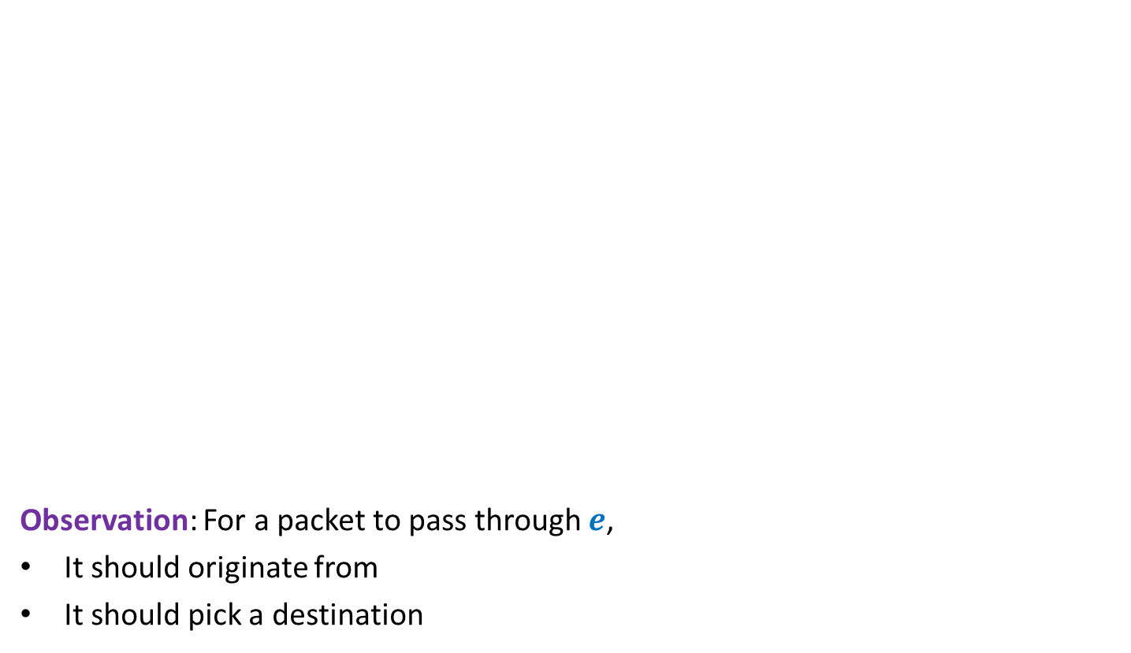






$X$($e$) : Number of routes passing through $e$
source
$$j$$
Observation: For a packet to pass through $e$,
It should originate from
It should pick a destination
$$P$$
$$d_{1}…d_{i−1}1 s_{i+1}…s_{n}$$
$$e$$
$$d_{1}…d_{i−1}0 s_{i+1}… s_{n}$$
$E[X(e)]$ = $\frac{1}{2}$
destination
$$∗∗∗∗∗1 s_{i+1}…s_{n}$$
No. of Packets = $2^{i−1}$
$$d_{1}…d_{i−1}0 ∗∗∗∗∗$$
Probability = $\frac{1}{2^{i}}$

Slide 20


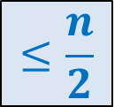
$X$($e$) : Number of routes passing through $e$
source
$$j$$
Lemma: $E[\sum_{e∈P}{X(e)]}$ = ?
$$P$$
$$d_{1}…d_{i−1}1 s_{i+1}…s_{n}$$
Are $X(e)$’s independent ?
$$e$$
$$d_{1}…d_{i−1}0 s_{i+1}… s_{n}$$
$E[X(e)]$ = $\frac{1}{2}$
destination
$$≤\frac{n}{2}$$

Slide 21


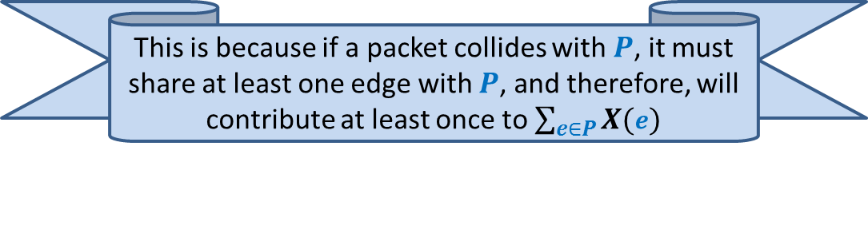
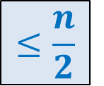
$H$($j$) : number of other packets colliding packet $j$
Question:
For any path $P$,
what is the relation between $H$($j$) and $\sum_{e∈P}{X(e)}$
$H$($j$) $≤ \sum_{e∈P}{X(e)}$
Lemma: Expected value of $H$($j$) = ?
$$≤\frac{n}{2}$$
This is because if a packet collides with $P$, it must share at least one edge with $P$, and therefore, will contribute at least once to $\sum_{e∈P}{X(e)}$

Slide 22
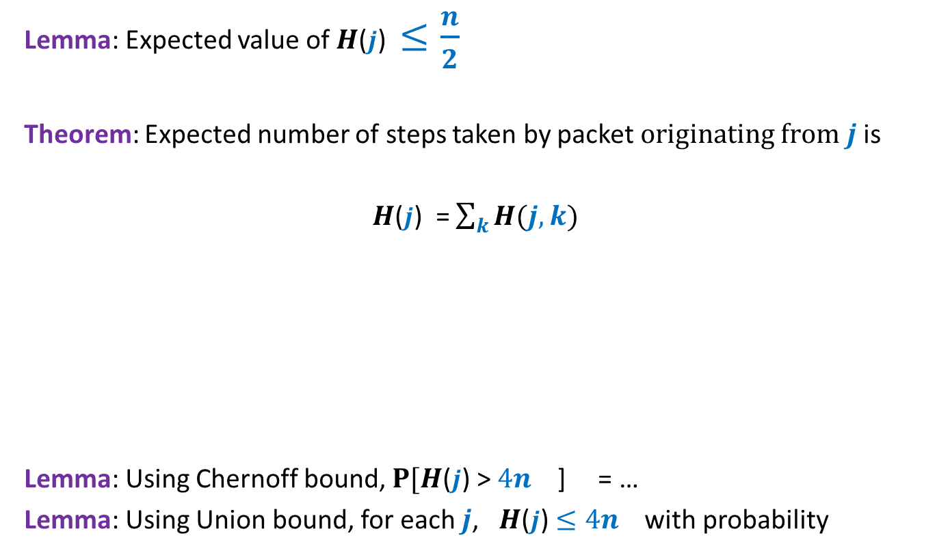

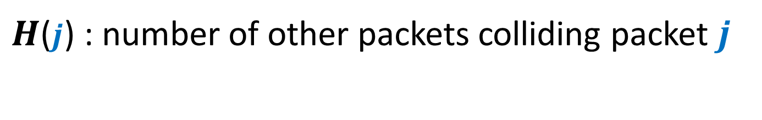
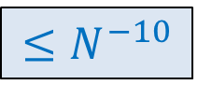

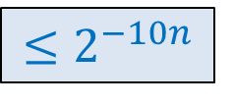

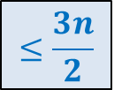
$H$($j$) : number of other packets colliding packet $j$
Lemma: Expected value of $H$($j$) $≤\frac{n}{2}$
Theorem: Expected number of steps taken by packet $originating from j$ is
$H$($j$) = $\sum_{k}{H(j,k)}$
Lemma: Using Chernoff bound, $P[H$($j$) > $4n$ ] = …
Lemma: Using Union bound, for each $j$, $H$($j$) $≤4n$ with probability
$$≤\frac{3n}{2}$$
$$H\left(j,k\right)=\left\{\begin{aligned} 1 if packet originating from k collides with j \\ 0 if packet originating from k does not collide with j\end{aligned}\right.$$
$${≤2}^{−10n}$$
$$6n$$
$${≤N}^{−10}$$
$$6n$$
$${≥1−N}^{−9}$$

Slide 23
How to design an efficient Algorithm for Permutation Routing ?
You will be amazed to see the algorithm.
This algorithm is inspired by the analysis for
Routing for Random destination
that we carried out recently.

Slide 24
How to design an efficient Algorithm for Permutation Routing ?

Slide 25
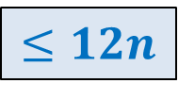
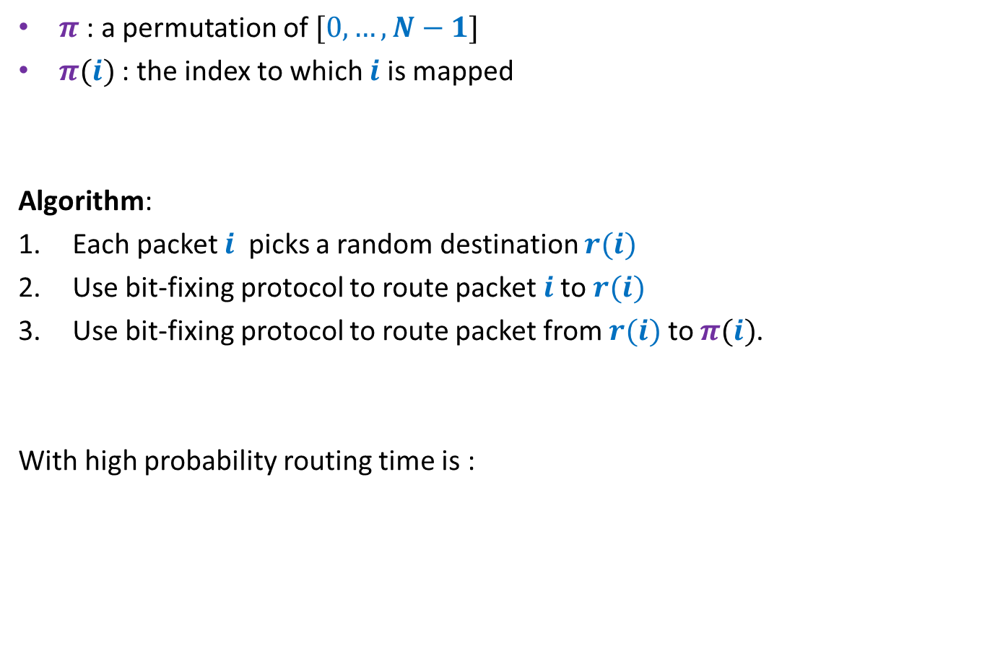
Algorithm
$π$ : a permutation of $[0,…,N−1]$
$π(i)$ : the index to which $i$ is mapped
Algorithm:
Each packet $i$ picks a random destination $r(i)$
Use bit-fixing protocol to route packet $i$to $r(i)$
Use bit-fixing protocol to route packet from $r(i)$ to $π(i)$.
With high probability routing time is :
$$≤12n$$

Slide 26
Fixed Path Routing

Slide 27
Dilation :
Congestion :
Queue management :
The maximum length of any path
The maximum number of packets that cross any edge
Policy of breaking ties

Slide 28

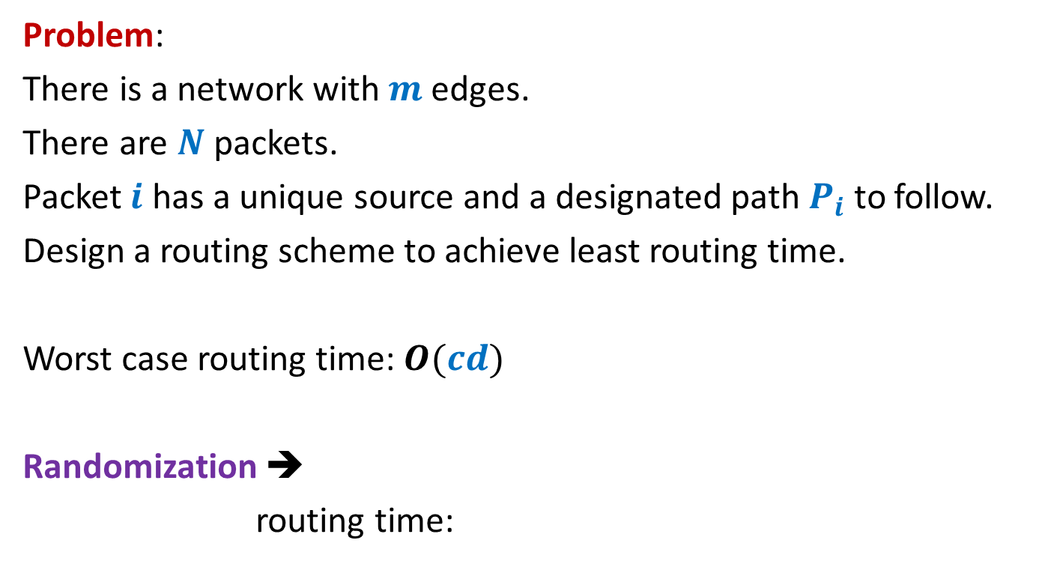
Arbitrary network
Problem:
There is a network with $m$ edges.
There are $N$ packets.
Packet $i$ has a unique source and a designated path $P_{i}$to follow.
Design a routing scheme to achieve least routing time.
Worst case routing time: $O(cd)$
Randomization ➔
routing time:
$$O(c+d log mN)$$

